Slide 1

Minor Project
Real estate price predictor
Dimple Saraogi (075BCT034)
Erosha Paudel (075BCT035)
Bishal Chaudhary (075BCT027)
Beenay Basnet(075bct21)

Slide 2
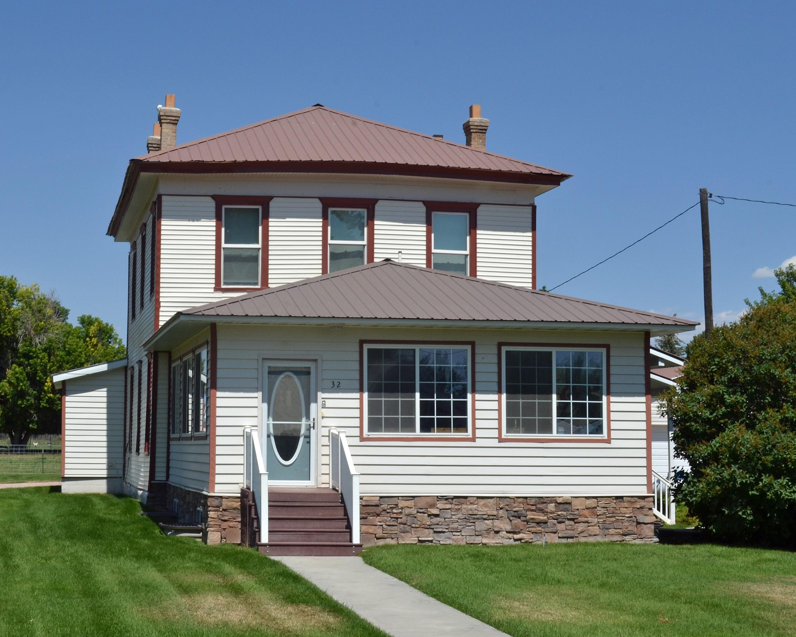

Objectives
Understand the tools and frameworks with the hands on ML
Give the best price prediction for houses.

Slide 3

Existing System
Problem faced during buying a house:
Buyers are generally not aware of the factor that influences the house pricing.
Hence,real estate agents are trusted that create a middle man which increase the cost of houses.

Slide 4
Proposed System
Data set of house prices will be taken with some features like number of bathrooms number of bedrooms,etc
The motive will be to create a model which will predict the price for any new house while looking at the features
The model will deal with real world data and not just artificial datasets.
F1
F2
F3
.
.
.
P
R
I
C
E
Model

Slide 5
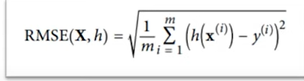
Type of model
Supervised learning-Because we have features and labels with us
Regression task-Give the value of prices
Batch learning-Data is already given and build a model.
Performance measure -RMSE

Slide 6
Methodology
05
Evaluation of model
RMSE
Data Collection
UCI ML repository
Real Estate price predictor
01
04
Application of algorithms
Multiple linear regression
Pre-Processing
Train-Test Splitting(Sklearn)
02
03
Data Analysis
Pandas library

Slide 7

Tools
Python as our coding tool.
Pandas library
Numpy
Scipy
Sklearn
Mathplotlib

Slide 8



Visual Studio Code
Jupyter Notebook
Github

Slide 9
Future Works
The code will be modular thus it will help for extension of this project in future
Add different features and go beyond houses
This model could check for new data time to time
Expand the dataset and produce better and more accurate results.

Slide 10
Literature review
Nepal- Brokers or middle mans are used for price prediction
A regression model created by A.S. Mark and W.B. John was beneficial in assessing house price changes in a given area.
There is also a similar model called REALas.com which does the same thing .

Slide 11
Expected Outcomes
The price of various houses is predicted using a regression model. It falls under the category of supervised learning, which is one of the machine learning categories. The multiple linear regression model is shown to be appropriate for predicting property prices and this project is hoped to give the price prediction with minimum errors.

